Slide 1
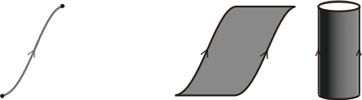
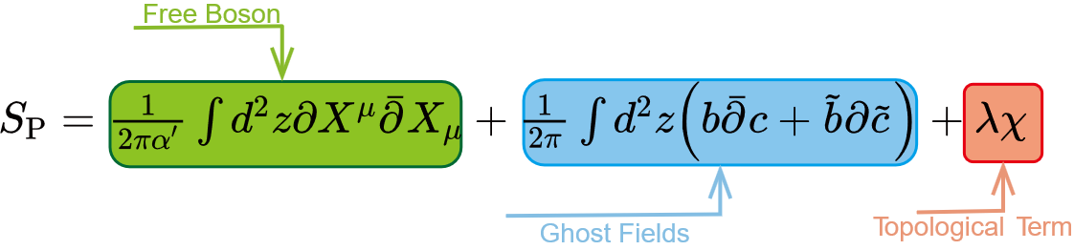
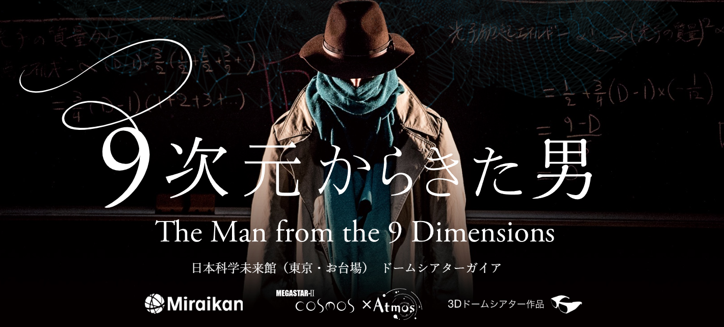



Warm-up: A quick review on superstring theory
$$S_{\text{pp}}=−m\int{dτ\sqrt{−η_{μν}\dot{X^{μ}}X^{ν}}}$$
$$S_{\text{NG}}=−\frac{1}{2πα^{′}}\int_{M}{dτdσ\sqrt{−det\left(η_{μν}∂_{a}X^{μ}∂_{b}X^{ν}\right)}}$$
String Theory is a sigma model on the worldsheet. It turns out string theory can be described by a free CFT on the worldsheet:
$$X^{μ}:\text{Rieman} \text{surface}↪\text{o}\text{ur} \text{spacetime}$$
$$b,c:\text{fix} \text{the} \text{diff}×\text{weyl} \text{gauge}$$
$$χ:\text{interactions}⟺\text{worldsheet} \text{topologies}$$
Unlike QFT, string theory's interactions are intrinsic and unique.
To avoid conformal anomalies, central charge should be zero, which implies D=26, 10

Slide 2
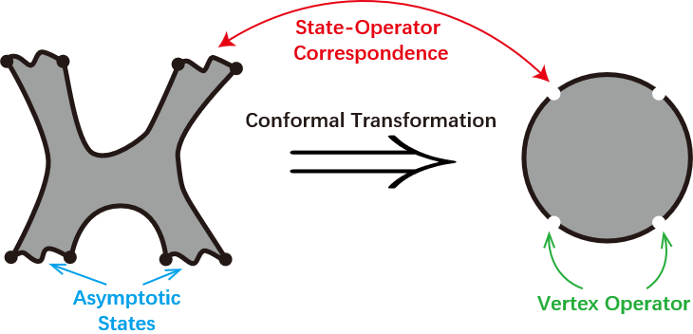
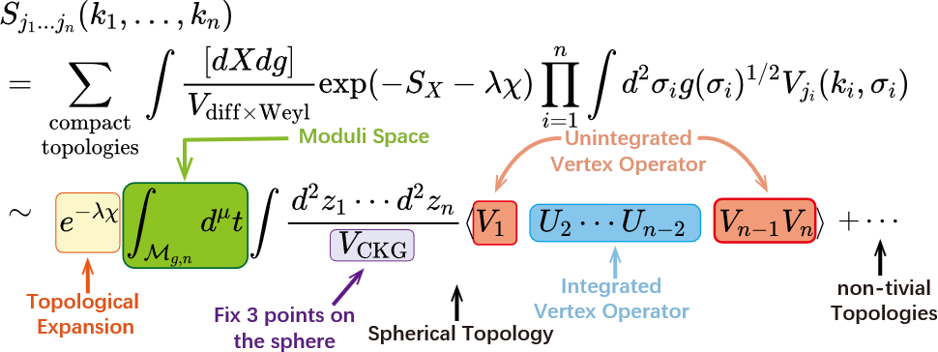
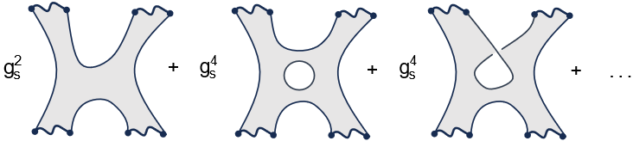

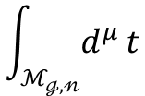

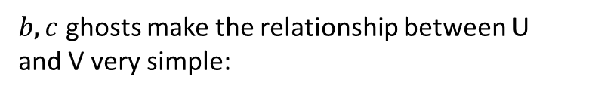




String Amplitudes: Bosonic String
Tachyon
$$\left|0;k\right\rangle ≅:e^{ik⋅X\left(0,0\right)}:$$
Photon
$$α_{−1}^{i}\left|0;k\right\rangle ≅:∂X^{μ}e^{ik⋅X}:$$
$$α_{−1}^{i}{\tilde{α}}_{−1}^{j}\left|0;k\right\rangle ≅:∂X^{μ}\overline{∂}X^{ν}e^{ik⋅X}:$$
Graviton
$b,c$ ghosts make the relationship between U and V very simple:
$$V=cU$$
$$\int_{ℳ_{ℊ,𝓃}}{d^{μ}}t$$
: integrate over all complex structures
$$e^{λχ}$$
: sum over worldsheet topologies
$$\int{d^{2}}z$$
: Amplitudes independent of worldsheet coordinates
$$V_{\text{CKG}}$$
: Conformal symmetries help us fix some points
V: inserted at fixed punctures U: integrated over the worldsheet
$$\left\langle ⋯\right\rangle$$
: Tree-level correlation functions can be computed using the OPE
QFT: off-shell correlation function on-shell amplitudes
String Theory: we only know how to define the on-shell amplitudes directly!

Slide 3

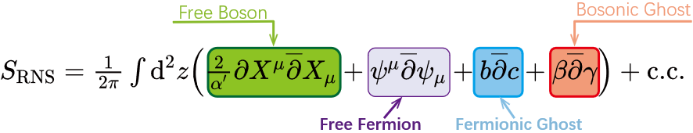
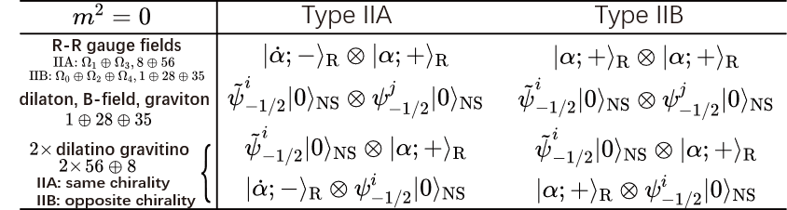







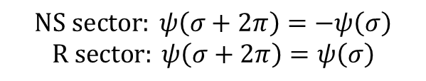

Superstring Theory
Worldsheet SUSY
RNS Formalism
Bosonic String
Spacetime SUSY
GS Formalism
What we really want
Can’t be quantized covariantly
$$ψ:spinor on the worldsheet$$
$$NS sector: ψ\left(σ+2π\right)=−ψ\left(σ\right)$$
$$R sector: ψ\left(σ+2π\right)=ψ\left(σ\right)$$
$$β,γ:\text{fix} \text{S}uper \text{diff}×\text{weyl} \text{gauge}$$
${But ℋ}_{CQ}$ is non-SUSY!
1-loop modular invariance
$$⇓$$
We need GSO projection
$$⇓$$
$$U^{\left(−1\right)}\left(z\right)=ε_{μ}ψ^{μ}\left(z\right)e^{−φ\left(z\right)}e^{ik⋅X\left(z\right)} for NS sector$$
Project $ℋ_{CQ}$ to SUSY part
$$V=cU$$
$$⇓$$
$$U^{\left(−1/2\right)}\left(z\right)=u^{α}S_{α}\left(z\right)e^{−\frac{1}{2}φ\left(z\right)}e^{ik⋅X\left(z\right)} for R sector$$
Type IIA\B superstring
The definition of amplitudes is analogous to the bosonic string
SUSY is hidden, not broken!
RNS Formalism: Covariant quantization | Hide spacetime SUSY
GS Formalism: Manifest spacetime SUSY | Light-cone quantization only
We need Pure Spinor Formalism!

